Slide 1
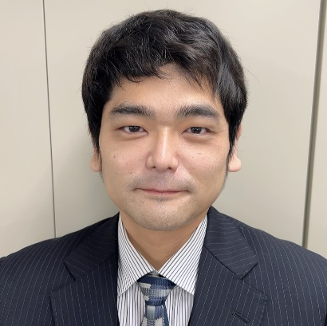
Product Showcase
IBD-PF2602-03
Product Showcase
For
Damage Prevention Valves
MAEZAWA Industries, Inc.
International Business Department
March 12th, 2026
Takaki Matsumoto
Assistant Manager
takaki_matsumoto@maezawa.co.jp
Notes:
Good afternoon, everybody.
My name is Takaki Matsumoto, assistant manager of international business department at Maezawa Industries.
Today I’m here to talk about “damage prevention valves”, especially emergency shut off valves.
Today’s topic is flood control, so you might be wondering why I’m introducing valves.
As you know, Japan is one of the most earthquake-prone countries in the world.
Earthquakes can cause not only natural disasters such as floods and landslides, but also damage urban infrastructure, resulting in flooding.
For example, huge earthquakes happen, water supply pipelines are broken and leads to water leakage and flooding in residential areas.
Furthermore, Flooding delays recovery and increases economic losses.
From a resilience perspective, it is important to prevent secondary disasters such as flooding.
So, I will introduce Maezawa’s valve as a solution to this issue by looking at real examples from Japan.

Slide 2
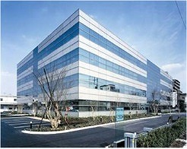



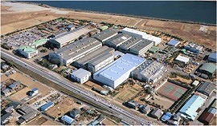


Company Perspective
・Head Office Saitama, JAPAN
・Established July 15,1937
・Business scope Manufacture, sales and installation of equipment
＆ apparatus for water supply and sewage systems
Public sector
Valve Business
-Purified Water supply
-Sewage Treatment
-Industrial Water supply
Environment Business
Head Office
Private sector
Industrial Environment Business
-Industrial Wastewater
-Soil and Ground water remediation
-Recycle
Biomass (gas) Business
Saitama Plant
Notes:
To begin with, I’d like to introduce Maezawa Industries, inc.
Maezawa Industries had been established in 1937.
Since then, we have been engaged mainly in the manufacture and sale of water supply and sewerage equipment, as well as water treatment devices.
We have 4 business lines.
Most of our sales are in the public sector.
the Valve business line provides Many types of valves for waterworks and sewerage applications.

Slide 3
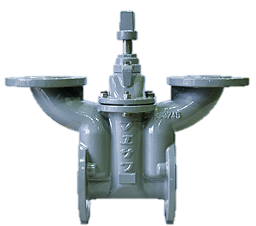
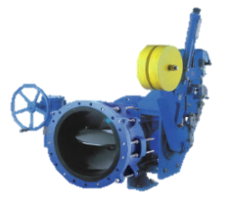
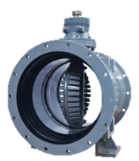
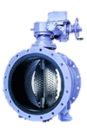
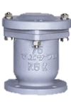
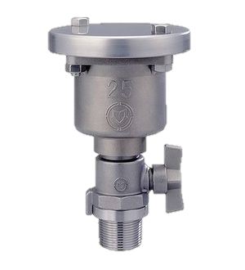
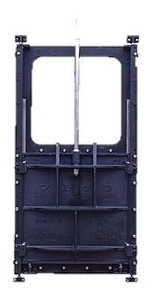
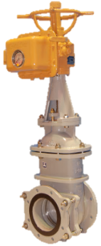
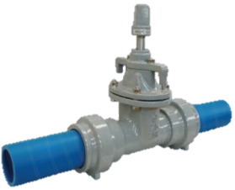
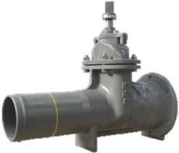
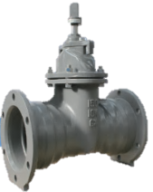
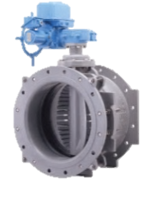
Our Signature Products for waterworks
2-way control
Cavitation Suppression
Multipurpose Valve
Antiseismic Valves
Air Valves
E.S.O.V
Double way Butterfly Valve
Jetport
Easy Maintenance Valve & Gates
2-Port Valve
Spigot / Socket end type
Socket ends type
PTC B22 Gate Valve with PE ends
GX Resilient seated gate valve
A/F Gate Valve
A/F Butterfly Valve
Splitable Gate
Notes:
This slide shows our signature products for waterworks.
Among them, I would like to introduce Emergency Shut Off Valve, ESOV, for flooding prevention.

Slide 4
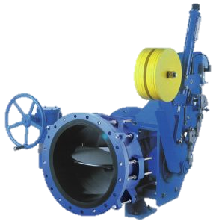
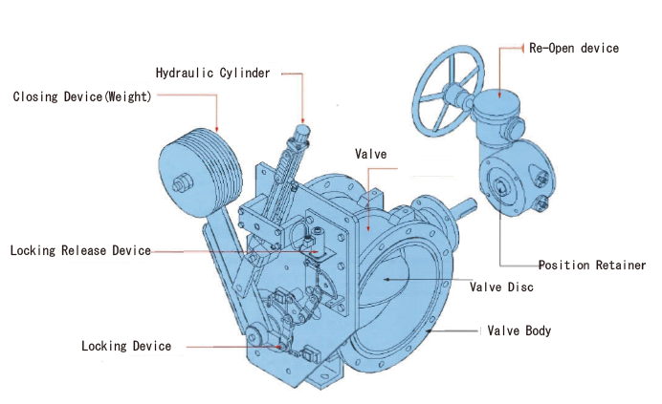
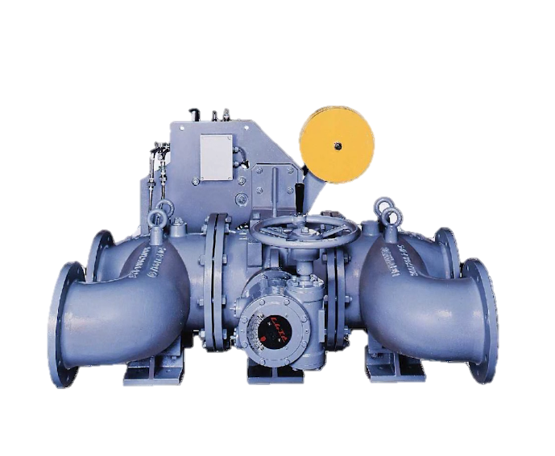
Adjustable Flanged
Emergency Shut Off Valve
Adjustable Flanged Automatic shut-off feature triggered
by earthquake ,electrical signal and water flow. The best solution for aseismic flow control in the water distribution system.
Adjustable Flange will make the removal/installation quick and easy for maintenance
21
Notes:
This valve is called E.S.O.V. with Adjustable Flange.
E.S.O.V will stop water flow to keep water from running off the water tank and reservoir in emergency.
There are many sensing methods available for ESOV such as Earthquake sensing, Flow Velocity Sensing using a Flow Meter, etc.

Slide 5
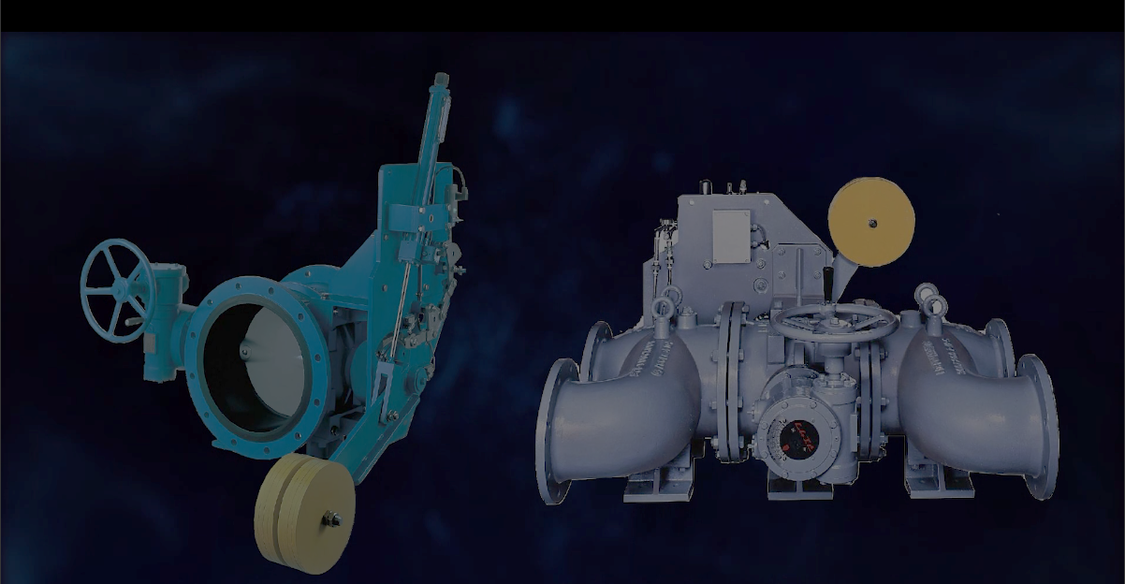
Features
Shut off the pipeline in an emergency
Various shut off ways with variety of sensing methods
Reliable rocking devices
Safe and secure shut off sequence
Never fail to shut off during power outage
Can conduct the operation inspection without shutting off the water supply
Notes:
This slide shows features of ESOV.
1. Shut off the pipeline in an emergency
2.Various shut off ways with variety of sensing methods.
3. Reliable rocking devices
4. Sage and secure shut off sequence
5. Never fail to shut off during power outage.
6. Can conduct the operation inspection without shutting off the water supply

Slide 6
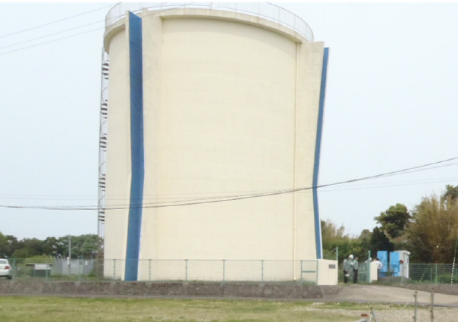
The Role of E.S.O.V (1)
These are examples of reservoir tanks for potable water. E.S.O.V can be installed right after these reservoir tanks.
Notes:
Now, let’s take a closer look at actual disaster impacts and how ESOV is used in practice.
These are examples of reservoir tanks for potable water.
E.S.O.V can be installed right after these reservoir tanks.

Slide 7
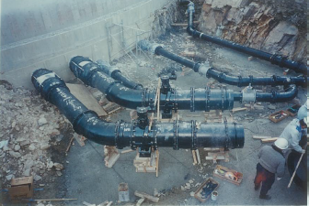
The Role of E.S.O.V (2)
Outlet pipe from the reservoir buried underground
Notes:
There are pipelines for inflow and outflow located underground of reservoir tanks that are extended to the distribution area

Slide 8
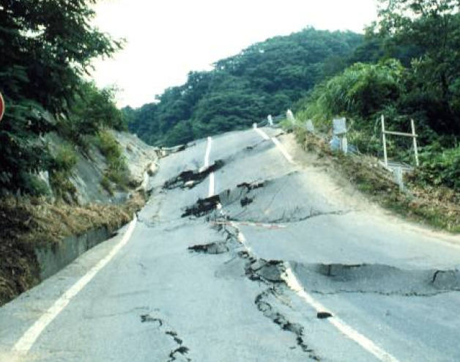
The Role of E.S.O.V (3)
Earthquake may cause damages by;
Strong bounce and roll
Landslide
Collapse and fall
Uplift and swell of land
Notes:
When major earthquakes occur, those pipelines will be affected by land slide and uplift

Slide 9
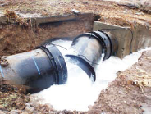
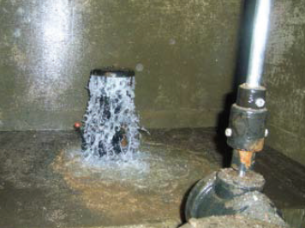
The Role of E.S.O.V (4)
Water main break & come off
Air-Valve broken by water hammer
Notes:
These are examples of actual damage of water pipeline infrastructure.
the pipeline is flowing out.
Pipeline has been force disconnected by the land movement and air valve has been damaged by water hammer.
In both cases water leaking has occurred resulted in the drainage of potable water.

Slide 10
The Role of E.S.O.V (5)
Water main break causes road closure by flooding and leakage of potable water
Notes:
The discharged water in residential area may cause flooding of surrounding land and homes and blocking traffic.
Such a situation could disrupt infrastructure, delay disaster recovery, and increase economic losses.

Slide 11
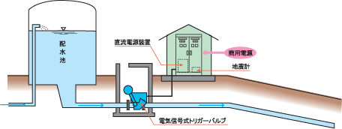
The Role of E.S.O.V (6)
E.S.O.V can be located right after reservoir in order to retain potable water and to prevent lifeline systems from the outbreak of second disaster
Reservoir
DC Power Supply
Commercial Power Supply
Seismometer
Electric signal triggered E.S.O.V
Notes:
In order to prevent such damages, E.S.O.V. can be installed at the outflow pipeline of water reservoir tank.
E.S.O.V are usually equipped with earthquake sensor or flow sensor to shut off the water flow in case of emergency.

Slide 12
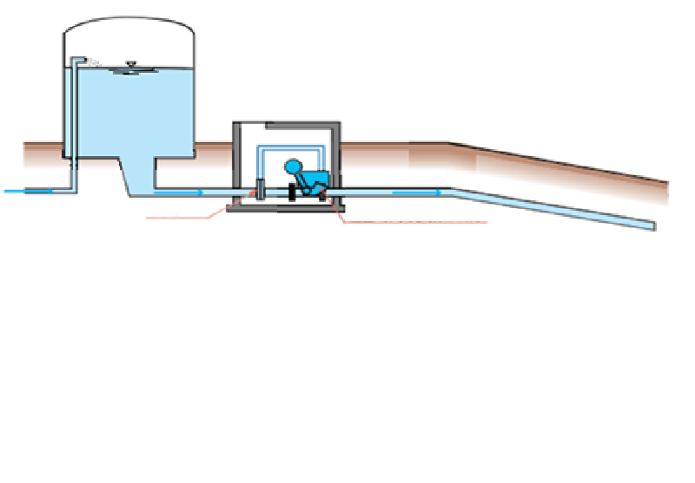
The Role of E.S.O.V (7)
E.S.O.V can be also operated standalone, without control panel
Reservoir
Orifice
Hydraulic Cylinder Type E.S.O.V
Notes:
E.S.O.V. with Hydraulic Cylinder Mechanism can be installed without a control panel.
(By using an orifice on the primary side and connecting a small pipe.
When a pressure difference occurs between the primary and secondary sides of the orifice, E.S.O.V. will shutoff the flow.)

Slide 13
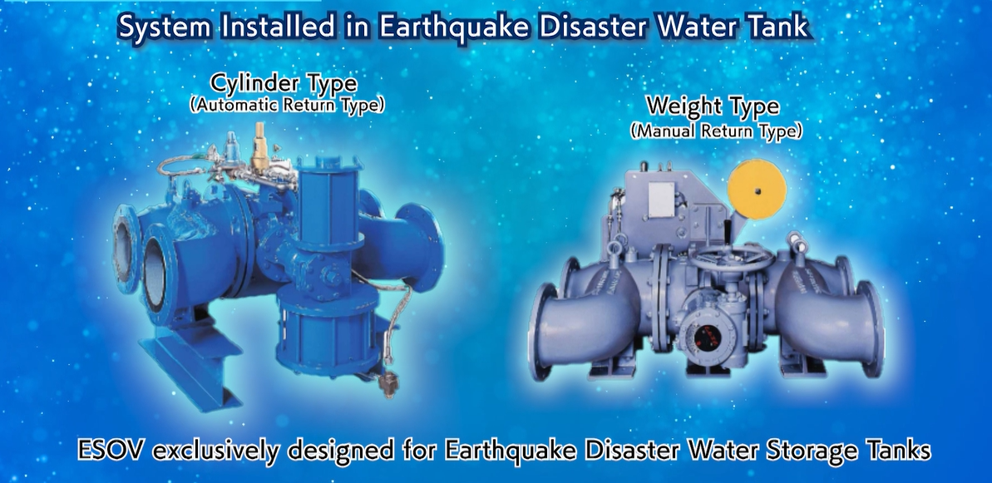
The Role of E.S.O.V (8)
Notes:
These type of ESOV are exclusively designed for Earthquake Disaster Water Storage Tanks.

Slide 14
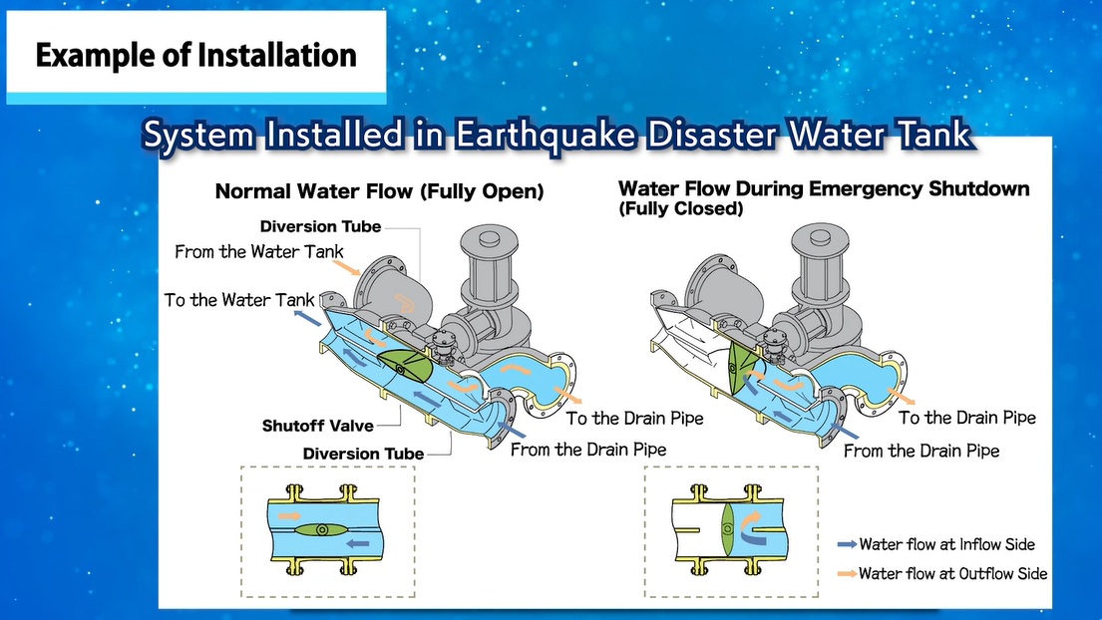
The Role of E.S.O.V (8)
Notes:
The water circulates in the tank through the pipes and in an emergency, the water is secured in the tank by shutting off the connection to the drain-pipe.

Slide 15
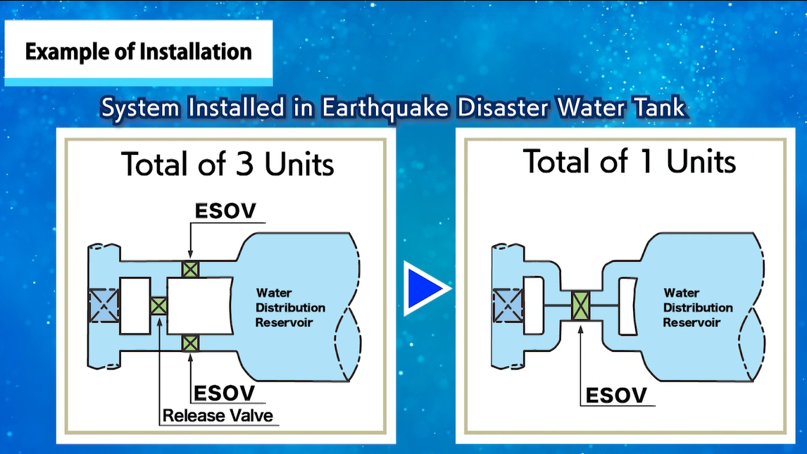
Notes:
This single unit type ESOV provides the functionality of 2 normal ESOV and Release Valve.
From the perspectives of initial cost, daily maintenance and post-disaster recovery, it provides unique benefits not found in other products.

Slide 16
Case and Cost
User | Specification |  |  | Cost ($/unit)
Tokyo Metropolitan Government | φ700 | Manual | WTP | 74,000
Suzaka City | φ400 | Manual | WTP | 35,000
Countryside Village | φ200 | Electric | WTP | 19,000
Fujinomiya City | φ150 | Manual | WTP | 14,000
Touon City | φ400 | Manual | Earthquake Disaster Water Reservoir | 46,000
Misato City | φ300 | Manual | Earthquake Disaster Water Reservoir | 36,000
Touon City | φ200 | Manual | Earthquake Disaster Water Reservoir | 29,000
Notes:
Representative ESOV installation records and their respective costs are shown here.
ESOV has been implemented by numerous municipalities, including the Tokyo Metropolitan Government.
While prices vary depending on the valve diameter and specifications, they generally fall within the ranges shown here.
As a representative example, I would like to introduce a case from Tokyo Metropolitan Government.

Slide 17
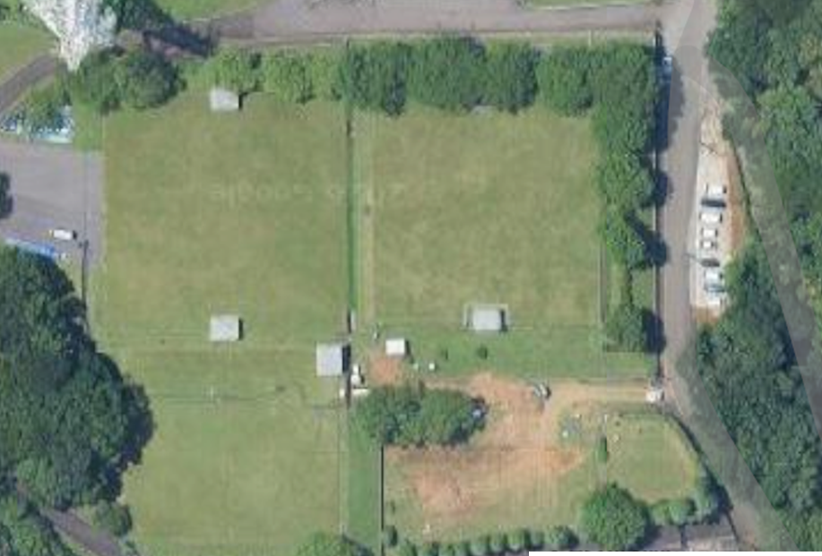
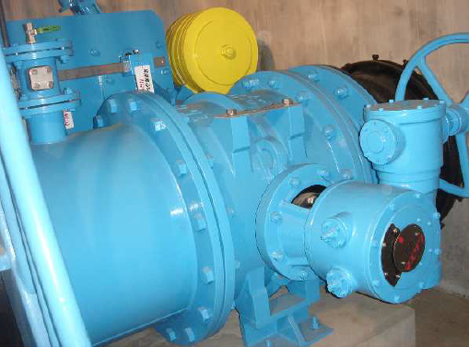
Case; Tokyo Metropolitan Government
■Installation image diagram
■Installation Purpose In case of emergency such as earthquakes, ground subsidence (1) Prevent flooding in residential area (2) Secure water in reservoirs for domestic and firefighting
■Specification of E.S.O.V. ・Diameter; φ700 (Flow rate; 1,300㎥/hr, Reservoir capacity; 19,000㎥) ・Abnormality detection; Mechanical flow sensor (Standalone, without control panel) ・Shutoff; when flow velocity reaches 1.5× the normal rate
Reservoir
Reservoir
No.2
Reservoir
No.3
E.S.O.V.
From WTP
To Residential area
Reservoir
No.1
E.S.O.V.
Notes:
Please look at the photo in the upper left. This is an aerial photograph of a reservoir.
There are three underground water tanks at this site, and they constantly store about 19,000 cubic meters of drinking water.
This facility is located on a hill, while the residential area is at a lower elevation.
Water is supplied to the residential area through pipelines by gravity.
Therefore, if the pipelines are damaged, flooding can easily occur in the residential area.
In addition, after major disasters in Japan, residential fires often break out in many locations because most houses are made of wood.
For these reasons, from the perspectives of both flood prevention and securing water for emergencies, an ESOV has been installed at this site.
The main specifications are shown here.
In this case, this ESOV has a mechanical flow sensor so that it can detect abnormal flow without electrical products and a control panel.
(when the flow velocity reaches 1.5 times the normal rate, the valve automatically closes.)
ESOVs are available with various specifications（, such as different abnormality detection methods and shut-off conditions.）
So, we can propose the most suitable specifications for each customer’s facilities and operating conditions.

Slide 18
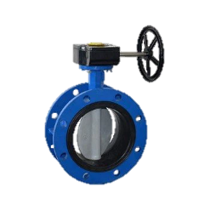
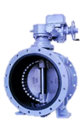
Example of Life Cycle Cost
4 replacement in 20 years
Cost : (Valve + installation cost )x 5
1 valve in 20 years
Cost: (Valve + installation cost) x 1 +maintenance fee
Year
0
5
10
15
20
Notes:
I would like to talk about the importance of product life cycle costs.
Maezawa Industries valves, if inspected regularly and used properly, can provide excellent performance for 20 to 30 years or more.
On the other hand, inexpensive valves may break down within 3 or 4 years of installation.
Our valves not only reduce the cost of the valves themselves, but also the cost of valve replacement, protecting your assets.

Slide 19
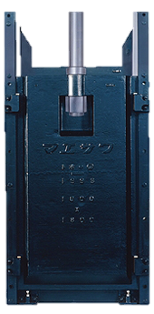
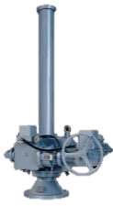
Quick Closing Gate
For Open Channel
Automatic quick closing feature will shut off the waterway in case of emergency by its own weight.
Adjustable shut down speed with excellent speed reduction system and reliable brake
Reliable self-weight closing with wet multi-plate electro magnetic clutch
Notes:
We have similar product designed for open channel as well.
The quick closing gate can shut off the channel.
The closing speed is around 2.0m/min ( while normal closing speed is around 0.3m/min), for instance, closing time is around 30sec while in regular closing time is more than 3 min.
This quick closing gate will protect facility such as water treatment plant, water purification plant and pumping station and so on.

Slide 20
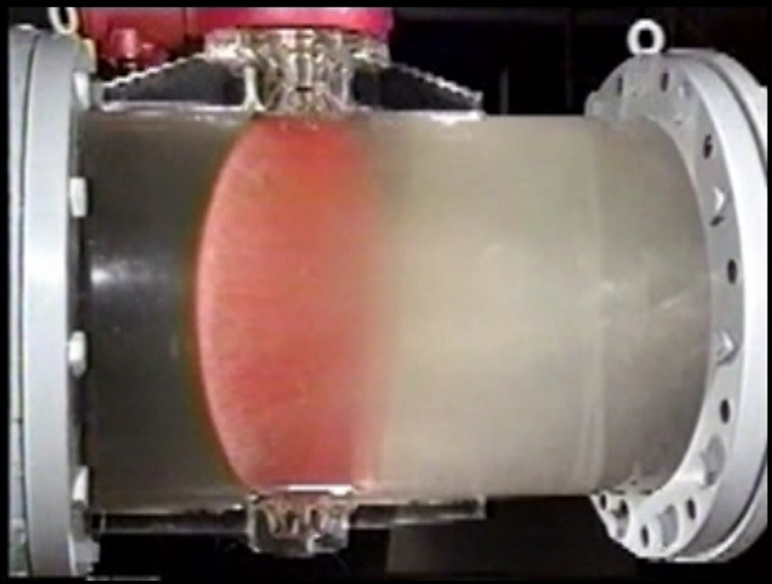
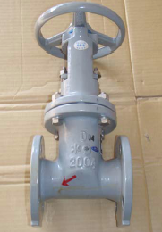
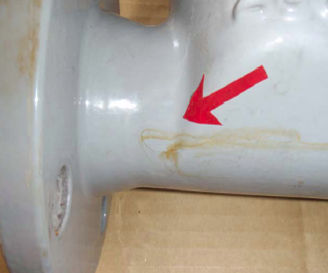
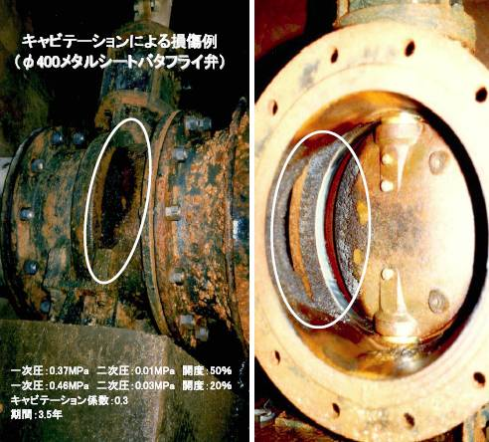
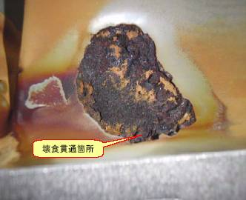
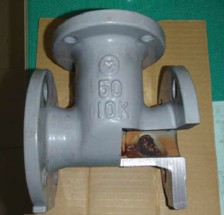
Cavitation Damage in Waterworks
A hole caused
by cavitation
corrosion
Damaged in 3.5years
Notes:
Due to time limitations, I will skip the details, In Southeast Asia, non-revenue water caused by leakage from valves and pipelines has become a serious issue.
This type of leakage can also be considered a form of invisible flooding damage in residence areas.
Damages to pipelines and valves like in this slide can be caused by a phenomenon known as cavitation.
The power of cavitation so huge that it will make a hole even in the valve body made of cast iron.
Cavitation will occur not only to the gate valve but also butterfly valve and other valves.

Slide 21
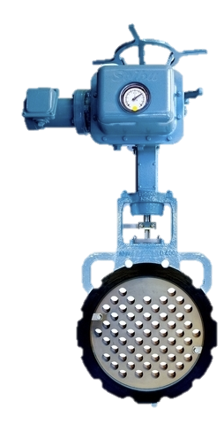
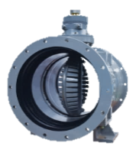
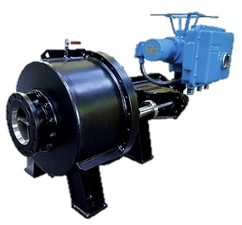

Our Control Valves with Cavitation Suppression Features
Doubleway Butterfly Valve
Uniport
- Multi-port Control Valve -
・Flow Control in Both Direction
・DN100 – DN1200
・Optimized Flow Rate for Water Filling
・Distributed Jet Flow Control & Rectification
・DN100 – DN600
・Stabilized Flow Control for all stroke
・Light weight and Compact design
LO-TM: Control butterfly valve
Disc with toothed vane
・Wide control range of flow
・DN100 – DN2400
・High durable simple structure
Caviless Valve
- Multi-jet Sleeve Valve -
・Low cavitation coefficient for all opening
・DN150 – DN1000
・Wide control rage
・Backwash feature
Jetport: Control butterfly valve
Disc with multi-port vane
・Wide control range of flow
・DN100 – DN1200
・High durable simple structure
Notes:
For its solution, Maezawa provides many types of control valves that are exclusively designed to suppress the occurrence of cavitation.

Slide 22
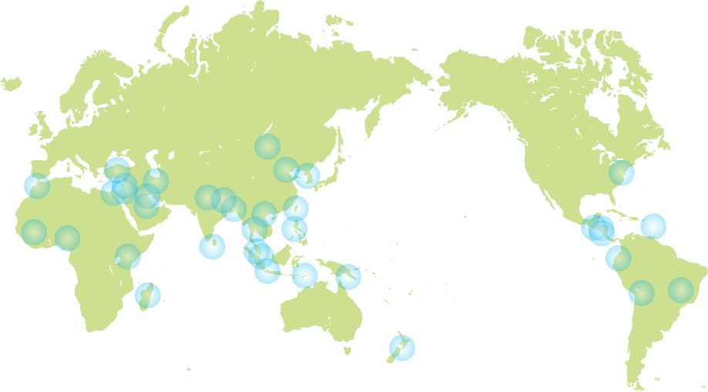
Global Sales Coverage
Algeria
Bangladesh
Bolivia
Brazil
Bhutan
Canada
China
Columbia
Congo
Ecuador
Hong Kong
India
Indonesia
Iran
Iraq
Jordan
Kazakhstan
Kenya
Kuwait
Madagascar
Malaysia
Mali
Mexico
Mongol
Morocco
Nepal
New Zealand
Nicaragua
Nigeria
Pakistan
Palau
Papua New Guinea
Philippines
Saudi Arabia
Sierra Leone
Singapore
Solomon Islands
South Korea
Sri Lanka
Sudan
Syria
Taiwan
Tajikistan
Thailand
Turkey
United States of America
Vietnam
Zambia
We have customers over 67 countries in the world
Notes:
We have many sales performances.
Our products are widely used not only in Japan, but also in many countries around the world.

Slide 23


詳しくは弊社のホームページをご覧下さい
For more information, visit our web site
http:/www.maezawa.co.jp/ja/index.html (日本語）
http://www.maezawa.co.jp/en/index.html (English)
Notes:
For more information, please visit our web sites or contact us freely.
I am confident that you will find a valve that can solve your problem.

Slide 24


Notes:
And that concludes my presentation. Thank you very much for your kind attention.

