Slide 1

ADB Water e-Marketplace session
The Introductions of RIAD System
River Image Analysis for Debris transport
Kentaro Toda
Junior Consultant
International Department, Yachiyo Engineering Co., Ltd.
25 July, 2023 @ Online
Notes:
Good Afternoon
My name is Kentaro Toda of Yachiyo Engineering.
I would like to introduce our system called RIAD, which can measure the amount of debris transported in rivers.
八千代エンジニヤリングの戸田と申します。
今回、私が紹介するのは、河川ごみの輸送量を測定するRIADというシステムです。

Slide 2
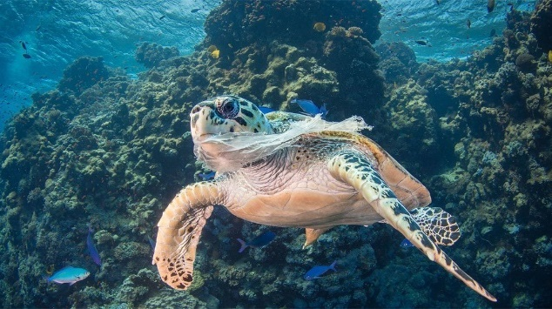
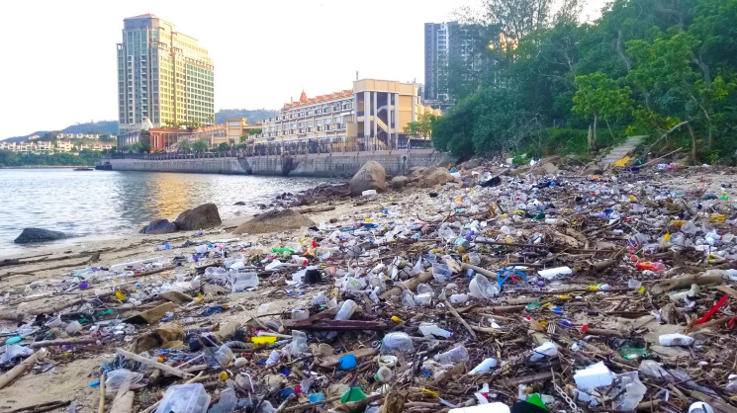
1. Marine plastic issues
Problem of Marine Plastic Pollution
Adverse effects on living creatures
Destruction of ecosystems
Marine Plastic Pollution
Pollution of the natural environment
Decrease in visitors and tourists
Landscape Destruction
Increase in plastic removal costs
Navigation hazard
Decline of the fishing industry
……
……
Source：United Nations “Plastic pollution choking world’s oceans”（2018）
Source：OCEANS ASIA “MASKS ON THE BEACH”（2020）
Notes:
Now, Marine plastic pollution has become a global problem.
Marine plastic affects natural and social environment.
There are concerns about a number of negative effects that indirectly affect our lives, such as the destruction of ecosystems, a decrease in visitors and tourists, and an increase in plastic removal cost.
現在、海洋プラスチック汚染は、世界的な問題となっています。
海洋プラスチックは生物や自然環境への影響のみならず、景観の破壊や船舶の故障などをもたらすことがあります。
その結果、生態系の破壊、観光客の減少、プラスチックの撤去費用の増大など、間接的に我々の生活にもつながる数多くの悪影響が懸念されます。

Slide 3
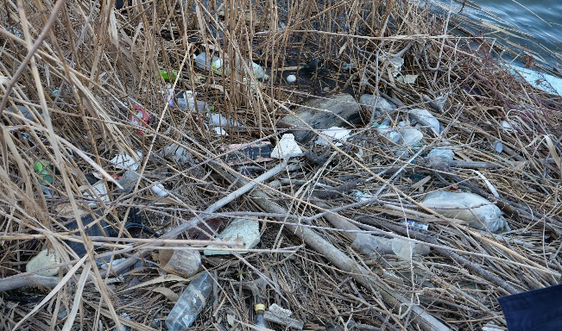
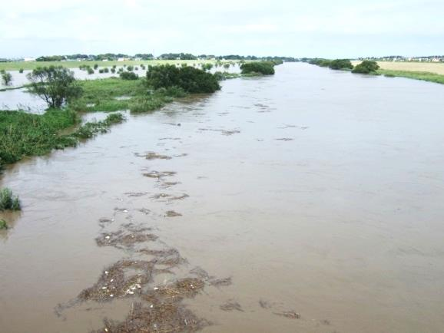



1. Marine plastics issues
Debris on riverside
Much riverine debris during overflow
flow
River Water
Riverine Debris
Rising water level
Edo River Noda Bridge
Overflow caused by Typhoon No.9 (Sep.7.2007）
Photo by Prof. Nihei Yasuo (Tokyo University of Science)
Plastics on riverside spills into river
Notes:
Many plastics are said to flow out to the sea via rivers.
The photo on the left shows a large river after heavy rainfall, and many floating particles can be seen.
When it rains, plastics on the riverside are also washed into the river due to the rising water level.
多くのプラスチックは、河川を経由して海域に流出すると言われています。
左の写真は、大雨が降ったあとの大河川の様子ですが、多くの浮遊物が確認できます。
雨が降ると、陸域にあったプラスチックが流されて河川に流出します。
同時に、写真に示すように、河川岸にあるプラスチックも、水位の上昇によって河川に流出します。

Slide 4
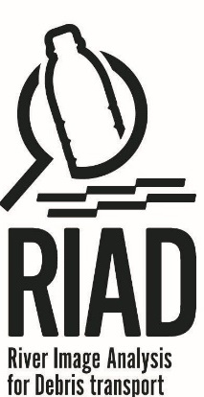
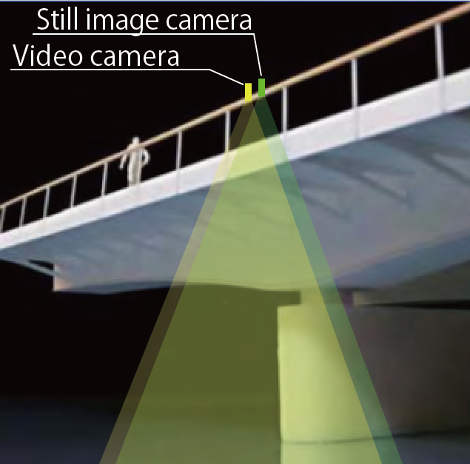
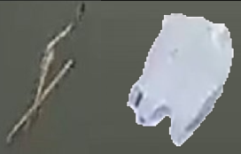
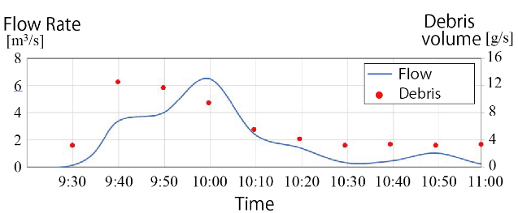
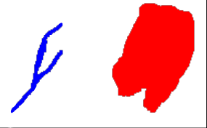
2. What is “RIAD” system ?
Riverine Debris Characters
Required Technology
■Much transported during overflow
■Float on water surface
■Includes natural (driftwood, leaf, etc.) and
anthropogenic (plastics, lubbers, etc.) debris
■Simple, Secured, Automated
■Effective imaging
■Distinguish natural and anthropogenic debris on water surface
Imaging & Analyzing natural and anthropogenic
debris transport from river
（RIAD：River Image Analysis for Debris transport）
※Refer to materials made by Prof. Nihei, Civil Engineering Dep., Engineering Science Fac., TUS
Automatic estimation of debris volume
Original image
Auto-selection of anthropogenic debris
Analyzing of numerical data
Acquisition of image
Processing of image
Notes:
Here, I explain what the RIAD system is.
RIAD, River Image Analysis for Debris Transport, is a system that uses this property to measure the amount of transported floating riverine debris.
Video images of the surface of river water from above a bridge are taken, looking downward.
By analyzing the video, the system automatically determines the amount of natural debris, such as grass and branches, and anthropogenic debris, such as plastics.
As shown in the graph, this makes it possible to determine the amount of floating debris over time.
河川ごみは、出水時に多く流出し、水面を浮遊するという性質があります。
その河川ごみの性質を利用して、河川ごみの輸送量を計測するシステムが、RIAD, River Image Analysis for Debris transportです。
まず、橋の上から河川水面を下向きに動画撮影します。その動画をRIADで画像解析することで、草や枝などの自然系のごみと、プラスチックなどの人工系のごみの量を自動で判別します。
それにより、このグラフに示すように、浮遊ごみの量を時系列で把握することが可能となります。

Slide 5
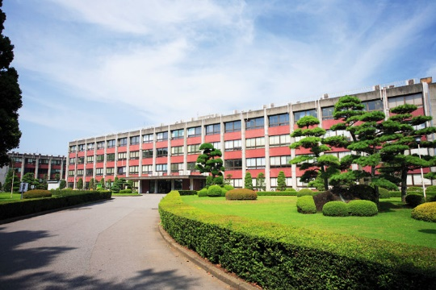

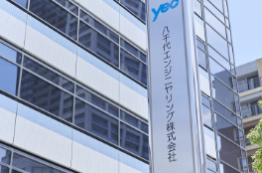


2. What is “RIAD” system ?
RIAD Development system
Developer
Systematization
Tokyo Univ. of Science Prof. Nihei
Ehime Univ. Assoc. prof. Kataoka
Yachiyo Engineering Co., Ltd.
Environmental Planning Dep.
Consulting Headquarters
■Develop automated way to identify riverine
debris（River Image Analysis for Debris transport）
■RIAD systematization
■RIAD promotion,
Societal implementation
■Global technology publication (Journal, etc...）
Improve RIAD accuracy based on demand
Realizing user demand &
societal implementation
Academia-Industry Cooperation &
Accelerate solving social issue on plastic
Notes:
RIAD is software developed by the Tokyo University of Science and commercialized by our company, Yachiyo Engineering.
Our company is systemizing RIAD and implementing it in society.
RIADは、東京理科大学によって開発され、私の会社である八千代エンジニヤリングが製品化を行ったソフトウェアです。
我々の会社が、RIADのシステム化や社会実装を行っています。

Slide 6
2. What is “RIAD” system ?
User
Imaging
Chart
Web browser
Imaging riverine surface with camera
①Upload videos
②Set condition ＆ analyze
③Output analysis result
Link
Link
Crowd
Pre-processing
program
Post-processing
program
Server
6
Notes:
We can use RIAD in cloud system.
By uploading the captured video and setting the analysis conditions, we can obtain the results of the analysis of the amount of floating debris transported.
RIADはクラウド上での利用をおこないます。
ユーザーは撮影された動画をアップロードし、解析の条件を浮遊設定します。これにより、ごみの輸送量の解析結果を得ることができます。

Slide 7
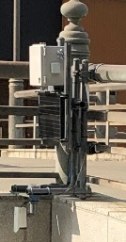
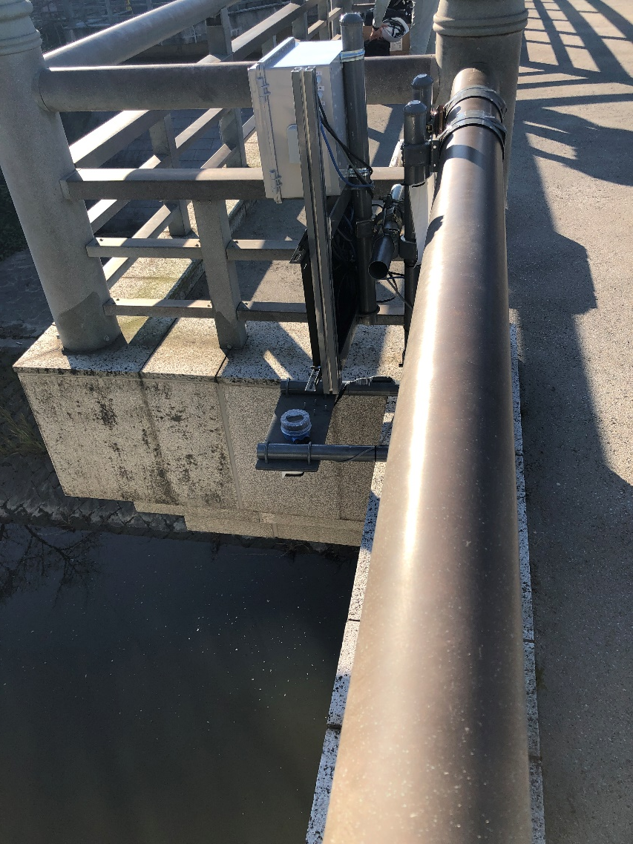
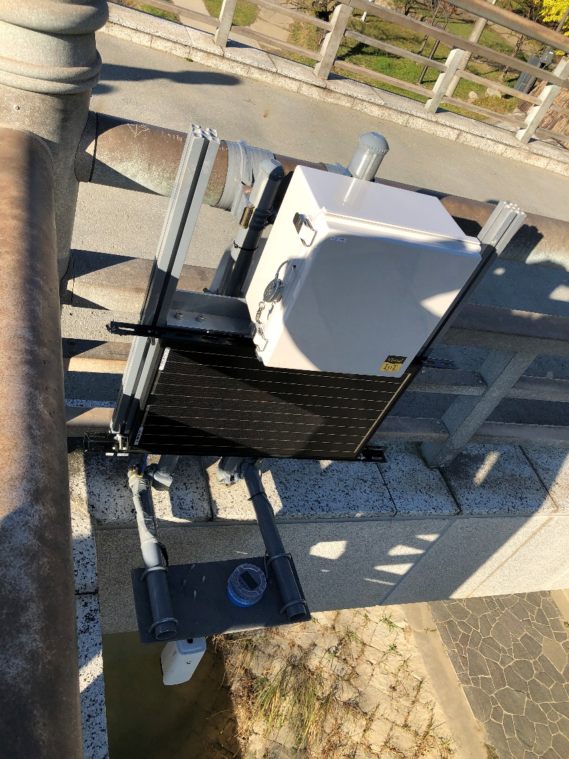
2. What is “RIAD” system ?
Case of Network Camera in Japan
Telecommunication equipment, Battery
Telecommunication equipment, Battery
Telecommunication equipment, Battery
Solar panel
Water gauge
Solar panel
Solar panel
Camera
Water gauge
Water gauge
Camera
Camera
7
Notes:
This shows the equipment for video recording installed on the bridge.
For continuous observation of floating debris, power is provided by a solar panel.
A water gauge and camera will be installed to start recording when the water level rises during overflow.
The video taken is then transmitted to cloud by telecommunication equipment.
これは橋に取り付けられた動画撮影のための機材です。
継続的に浮遊ごみの観測を行う場合、ソーラーパネルによって電源を確保します。
水位計とカメラを取り付け、出水時に水位が上昇したときに録画を開始します。
そして通信機器により撮影した動画がクラウドに転送されます。

Slide 8
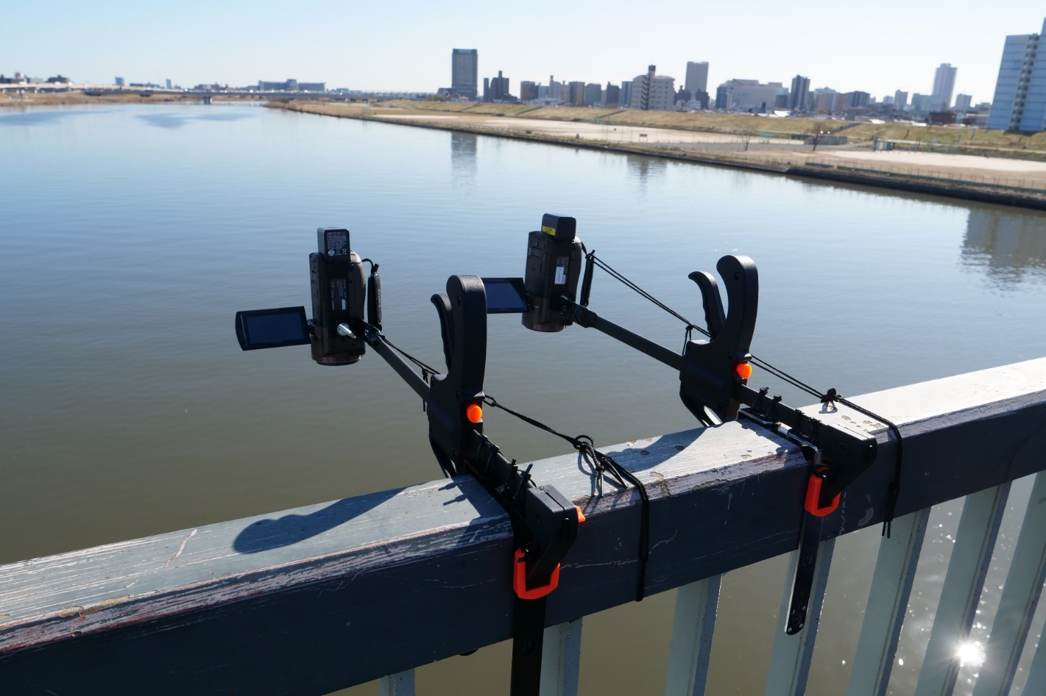
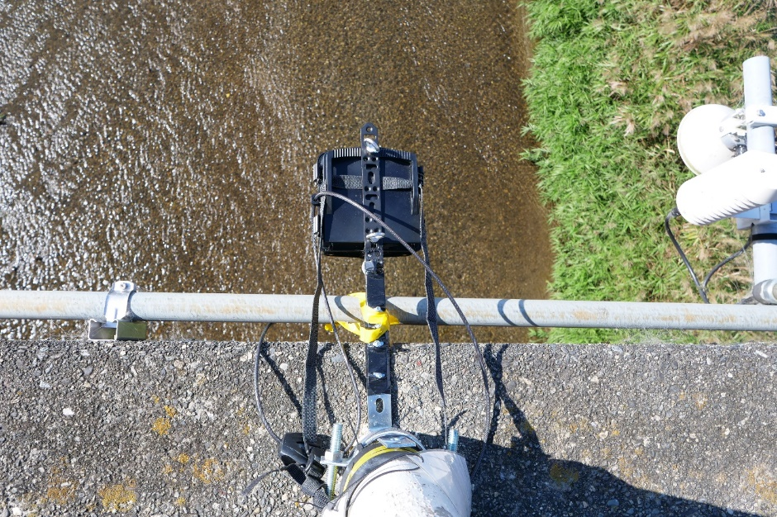
2. What is “RIAD” system ?
Case of Video Camera without Network
Notes:
For simple observations, videos can be taken with video cameras, interval cameras or smartphone.
簡易的に観測を行うには、市販のビデオカメラやインターバルカメラ、スマートフォンの撮影が可能です。

Slide 9
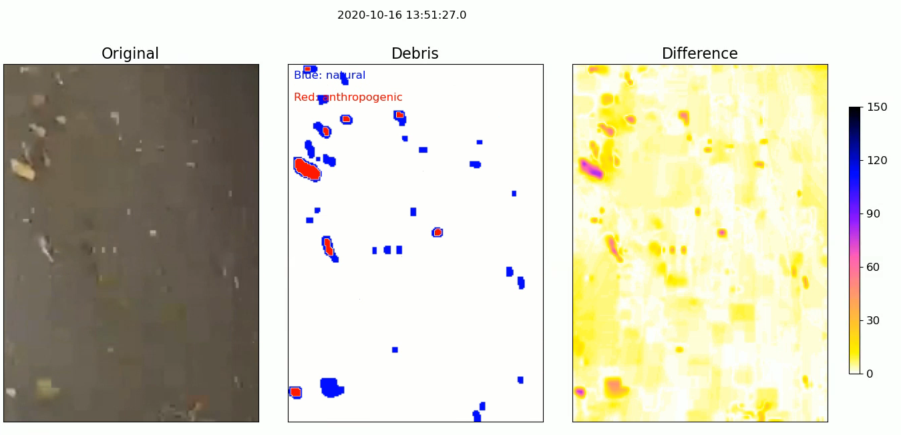
2. What is “RIAD” system ?
Blue：Natural Red：Anthropogenic
Riverine debris continuously extracted.
Natural（driftwood, leaf, etc. ) & anthropogenic（plastics, empty can, etc.）debris generally well-categorized respectively.
9
Notes:
This is part of a video showing the results of the RIAD analysis.
The blue areas indicate natural debris and the red areas are anthropogenic debris.
Here, we can see that PET bottles are identified as anthropogenic debris.
これは、RIADでの解析結果を示した動画の一部です。
青色の部分が自然系のごみを示し、赤色の部分が人工系のごみであることを示しています。
このように、PETボトルが人工系ごみに識別されていることがわかります。

Slide 10
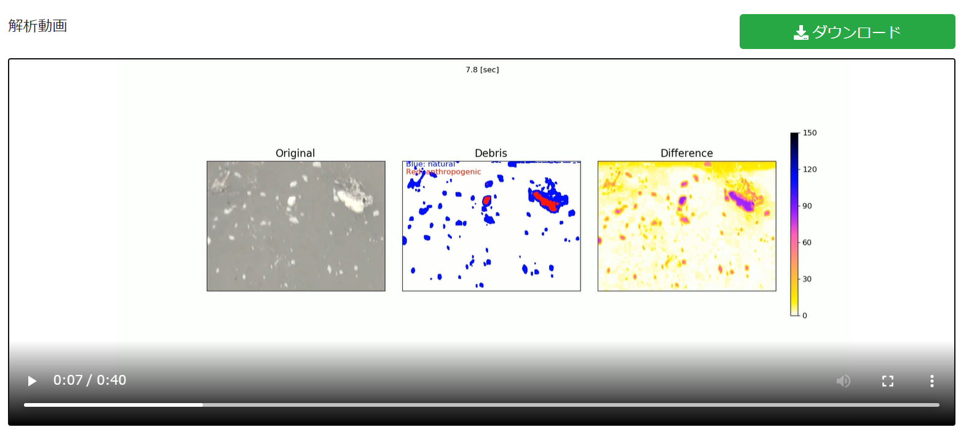
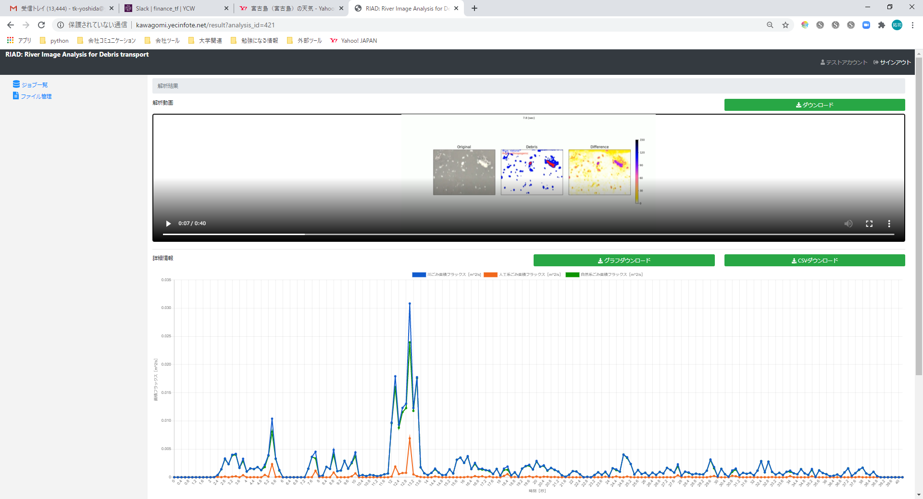
2. What is “RIAD” system ?
Analysis
Blue：Natural Red：anthropogenic
Output area flux per frame
10
Notes:
This is a screen of the analysis results in RIAD on the cloud.
As you can see, graphs can also be shown to visually monitor the amount of riverine debris.
これは、クラウド上のRIADでの解析結果の画面です。
このように、グラフで河川ごみの輸送量を視覚的に把握することも可能です。

Slide 11
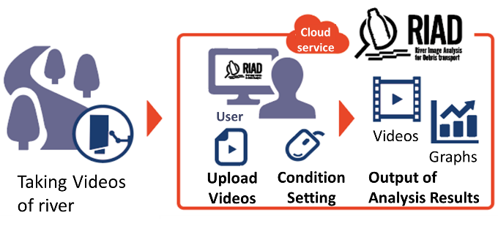
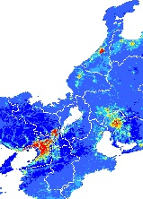
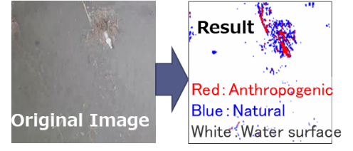
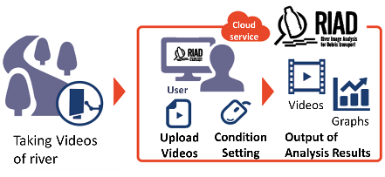
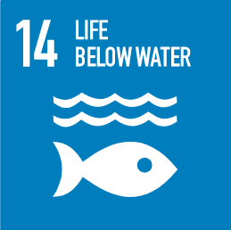
3. What we can achieve by RIAD system
【RIAD】
Establishment of monitoring network
Visualization of results
（Information on the
surface）
Results at observation “point”
⇒Information at a point
D River
a Channel
【Physical Properties】
■Land Use
■Population density
■Cross-section of a river
■Riparian vegetation
・・・etc.
C Channel
C River
b Channel
B River
City OS Utilization
A River
observation point
【RIAD】
Goal
Countermeasures (Example)
Confirmation of effectiveness
(scientific basis）
Reduce the amount of plastic discharged into the ocean to zero as much as possible.
【Society & Economy】
■Human abortion
■Waste Collection Status
■Scholarly ability
■Age structure
■Regional character
■Corporate activities
■Standard of living
・・・etc.
✓River improvement
✓Collected in river
（Oil fence etc.)
✓Countermeasures in lands
（Civic activity, etc.)
✓Based on the amount of waste generated in the region Sharing of disposal costs
City OS Utilization
・・・etc.
Notes:
So what can we achieve with RIAD?
RIAD can determine the amount of floating debris transported at a point.
It acquires data not only at a single point, but also upstream and downstream of a river and its tributaries, thus obtaining data for the entire watershed.
The results are then visualized as areal information by combining it with city OS, such as land use and population density.
Furthermore, social and economic indicators are combined and linked to specific measures such as river improvement, debris collection and so on.
In other words, based on objective data, measures can be efficiently implemented to reduce debris.
The effects of the measures also can be quantitatively evaluated by RIAD.
As a result, RIAD can contribute to the reduction of plastics in rivers and oceans..
では、RIADで我々は何を達成できるのでしょうか。
RIADではある地点の浮遊ごみの輸送量が把握できます。
一点だけの点データだけでなく、河川の上下流やその支流でもデータを取得し、流域全体のデータを取得。
そして、土地利用や人口密度など、都市OSと組み合わせることで、面的な情報として結果を見える化。
更に、社会・経済的な指標を合わせ、河川改修やごみの回収など、具体的な対策に結び付けます。
つまり、客観的なデータをもとに、効率的に河川ごみを削減するための対策を行うことができます。
そして対策による効果をRIADによって定量的に評価。
結果的に、河川や海域でのプラスチック削減に貢献します。

Slide 12
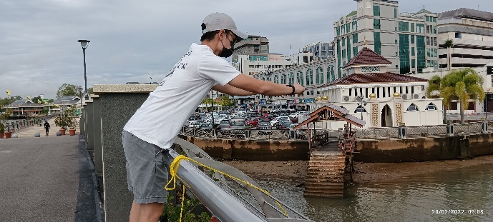
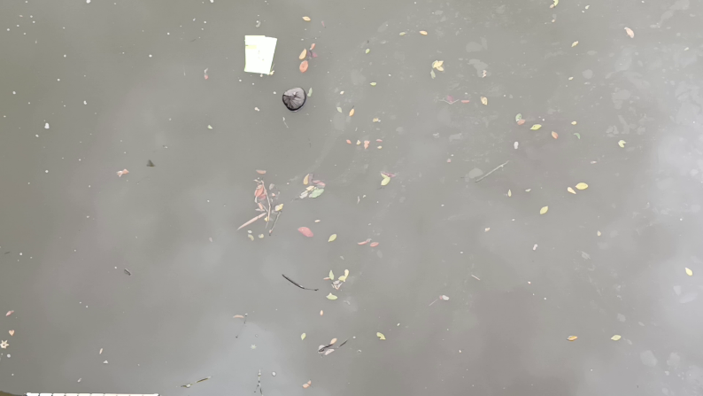
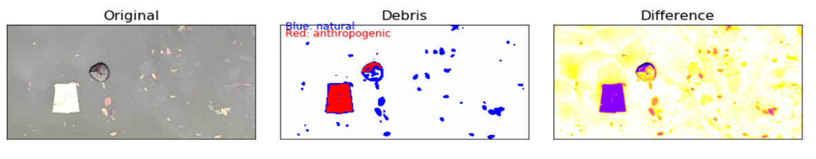






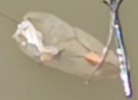
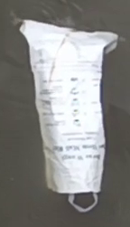











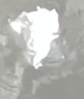





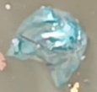






4. Using “RIAD” system in Brunei
Taking Video
Captured Video
Taking Videos for 6 mins every 1 hour
Natural and Anthropogenic debris
Analysis
Kedayan River
Brunei River
Kianggeh River
Captured Plastics (during 30 minutes)
12
Notes:
The use of RIAD can play an important role in monitoring and reducing marine plastic pollution in Southeast Asia.
This is an example of the use of RIAD conducted in Brunei last year.
In this study, no equipment was installed. Only simple videos were taken using a smartphone, to identify the amount of anthropogenic debris transported.
RIADの活用は、東南アジアにおいても海洋プラスチック汚染のモニタリングと削減に重要な役割を果たします。
これは、昨年ブルネイで実施されたRIADの活用事例です。
この調査では、機器を設置していませんが、スマートフォンを用いて簡易的に動画を撮影し、人工系ごみの輸送量が把握できることが示されました。

Slide 13
4. Applicability of RIAD system to Asia
Example of RIAD System Development Options
Scale | Purpose | Activities | Output
Simple Equipment | Spot research of RIAD observations | Rudimentary video shooting by handy video camera and analysis | Assessment of the amount of debris transport at selected sites
Intermediate equipment | Assessing how much floating debris comes from which areas | Installation of permanent cameras (few locations) and water gauge, power supply, data transfer by a digital media | Quantified video images by manual analysis
Full-scale equipment | Visualizing amount of floating debris in the main river and the major tributaries | Installation of permanent cameras(many locations) and water gauge, power supply, data transfer, formulation of a website for viewing the results. | Automatic data receiving processing unit, formulation of a website for viewing and accessing data of floating debris.
Using a river garbage scavenger machine (ex. THE OCEANCLEANUP’s Interceptor),
Installation of trappings at drainage outlets,
Installation of CCTV to monitor illegal dumping.
Notes:
in order to introduce RIAD in the Asian region in the future, it is necessary to develop it in stages.
First, as Simple Equipment, we will conduct spot observations using smartphones and video cameras without spending much cost.
Then, as Intermediate Equipment, we will select several locations and install network camera equipment.
For Full-scale equipment, we will further increase the number of observation sites and publish the results on a website.
We will need to confirm the stakeholders such as the local country officials, increase the number of observation sites, and develop the monitoring system.
今後アジア地域でRIADを導入していくには、段階的な展開が必要であると感じています。
まずは、Simple Equipmentとして、多くのコストをかけずに、スマートフォンやビデオカメラでの撮影で、スポットでの観測を行います。
その後、Intermediate equipmentとして、数カ所の地点を選定し、ネットワークカメラ機材を導入します。
さらに、Full-scale equipmentでは、観測地点を更に増やし、結果をWebサイトで公開します。
現地国の関係者の意向を確認しながら導入ヵ所を増やして、モニタリングを行えるように展開していく必要があります。

Slide 14
Thank you for your attention!

