Slide 1

Cloud-based
disaster prevention information OS
JULY 2023

Slide 2
1. Introduction of CTI group
Established in 1945, CTI was the first engineering consultancy established in Japan.
over
CTI Engineering Group has delivered over 800 international projects in over 100 countries.
First
800
projects
over
  CTI Engineering Group has sales of $604.6m (2020) and has the top share of sales to the government among consulting engineering companies in Japan.
3,800
CTI Engineering Group employs over 3,800 people in 13 Group companies.
Top
employees
Areas of Service
Notes:
CTI has expertise in many areas with its highly qualified engineers. We plan, design, supervise construction and maintain projects. CTI contributes to industrial development so people can live in safety and comfort.

Slide 3




2. Importance of Flood Forecasting/Early Warning System
  Government and private sectors must decide on evacuations and flood control measures before floods occur. Swift decisions and early evacuations save lives.
  Private companies like real estate managers and logistics companies also need countermeasures for flood disasters.
  However, reality presents the following problems:
  Information gathering for countermeasures takes a long time.
  Different systems for rainfall observation, forecast, flood forecast, and early warning are managed separately.
  Difficulty in accurate flood forecasting due to rapidly changing situations.
  Uncertainty about roles and responsibilities during disasters.
  Consequently, making evacuation decisions and flood control activities has become challenging.
  But there's a solution - RisKma!

Slide 4
3. Advantages of RisKma
  Integration and browsing of related information
  Ability to forecast of river water levels and inundation area
  Customizable functions (e.g. alert mail)
Structure of RisKma

Slide 5
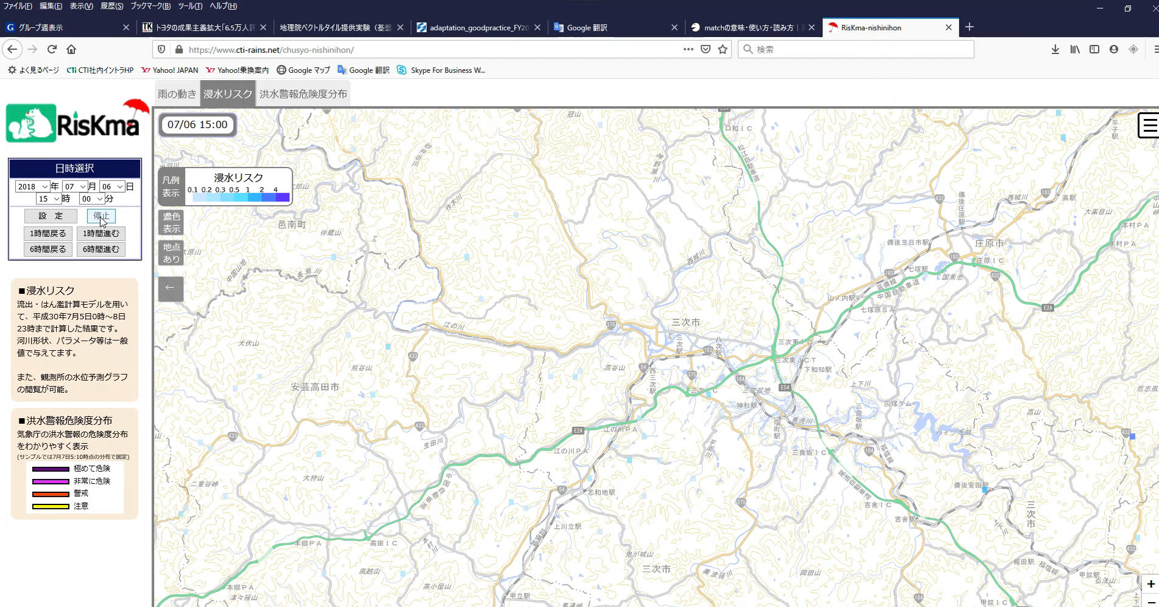
3. Advantages of RisKma (Example of RisKma in Japan)
  RisKma can provide Inundation forecast in real-time on the Client’s map
  Users can grasp the real-time & future flood risk

Slide 6









4．Success Story (Pilot project)
  Present: Status updates have been communicated through phone calls, text messages, and paper reports.
  Future: Posting status updates on a cloud-based platform enables centralized management and accelerates decision-making.
Evacuation situation
Water level
Observation data
All information can be integrated in the system
Local officer
Inundation
situation
report situation on his/her mobile phone
Local officer

Slide 7
4．Success Stories/ Sales Record of RisKma
  Riskma works with government agencies, and boasts the top share in Japan. We will expand the reliability and achievements of flood forecasting technology obtained in Japan to other countries.
Central/National Government
  No.1 market share position in Flood Forecasting System (Risk Line) of MLIT
  No.1 market share position in Dam Inflow Forecasting System
  of JWA
Local Governments
  Tomakomai city in Hokkaido
  (won the 2022 Minister's Award of Circulating Sewerage)
  Gunma Prefecture
  (won the 2022 Governor’s Commendation & Zenkensho Award)
Private Companies
  Real estate investment management company
  Manufacturers

Slide 8
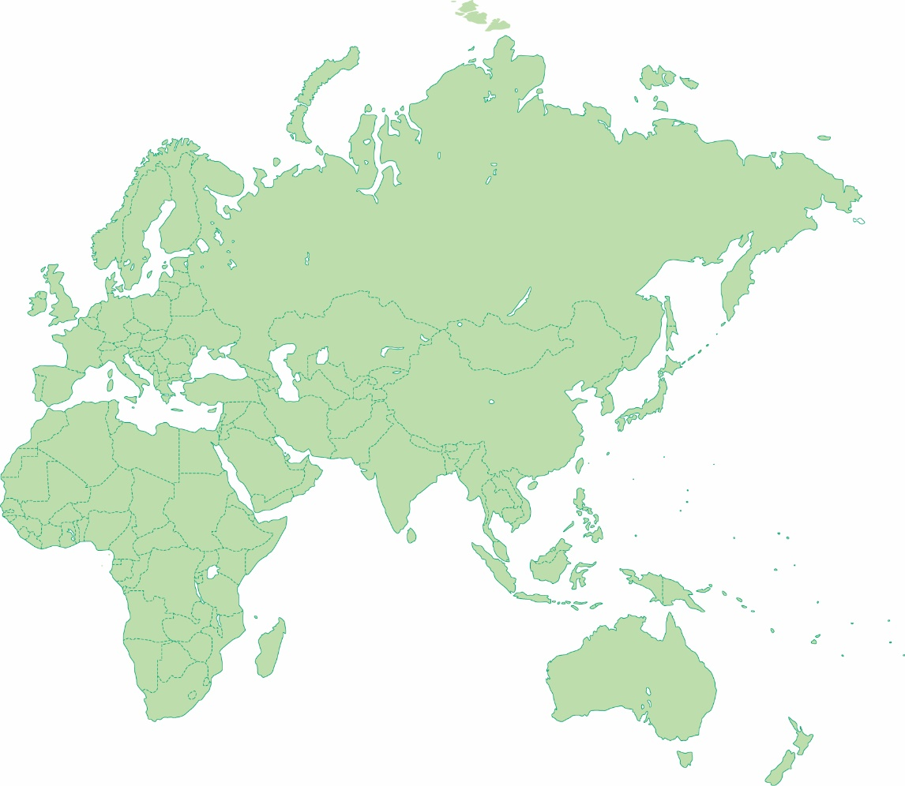
5． Overseas Offices of CTI Engineering Group
Dublin Office (Waterman)
Ulaanbaatar
Liaison Office(CTII)
Waterman Group (HQ)
Islamabad Branch Office(CTII)
CTI Engineering (HQ)
  CTI Engineering International (CTII)
  Japan Urban Engineering
  Chi-ken Sogo Consultants
  NISSOKEN ARCHITECTS/ENGINEERS
  Environmental Research & Solutions
  CTI Frontier
  CTI Reed
  CTI Wing
  CTI Ground Planning
CTI Myanmar (CTII)
Phnom Penh Liaison Office(CTII)
Jakarta Liaison Office(CTII)
Philippines Branch (CTII)
CTI Pilipinas (CTII)
Melbourne & Sydney Office (Waterman)

Slide 9
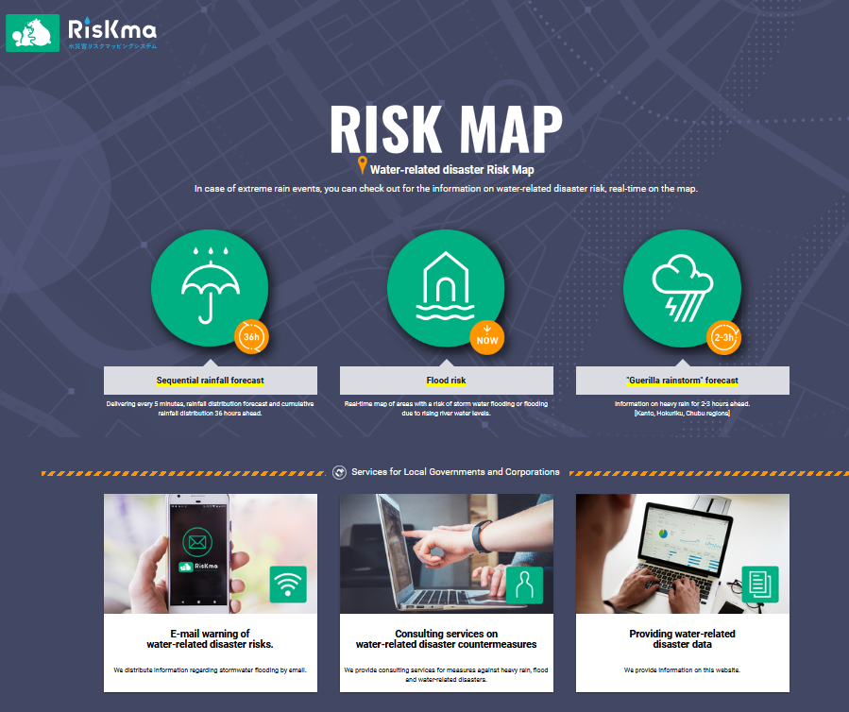
6． Access to RisKma
If you are interested in RisKma, please send email to “riskma@ctie.co.jp” with the subject "ADB e-Marketplace 2023".
Team RisKma is looking forward to discussing with you via email and web meetings!
RisKma HP
https://www.riskma.net/en/top

